Slide 1

Discovering Non-Redundant K-means
Clusterings in Optimal Subspaces
Reporter: Bai Lu
Zhao Peiyao
Yao Xiaoying
Wang Dezhao
Zhang Zixuan
Report Time：29/11/2018

Slide 2
Part One
Introduction
Presented by Bai Lu

Slide 3
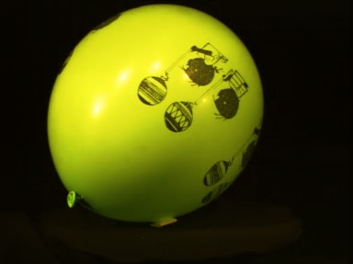
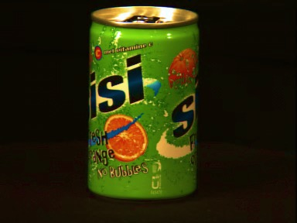
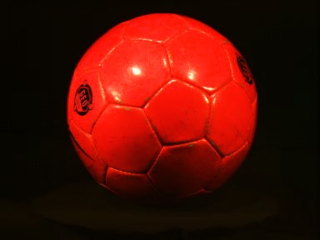
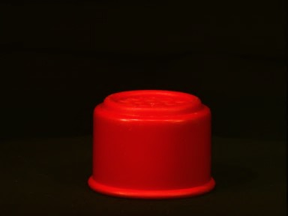
Introduction

Slide 4
Introduction
Limits
1. Two equally meaningful ways to group objects.
2. Fail due to the curse of dimensionality.

Slide 5
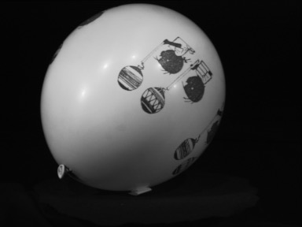
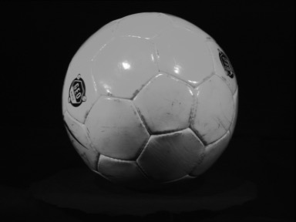
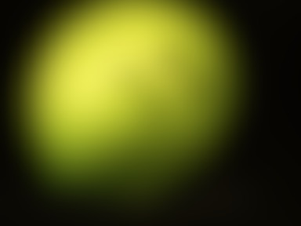

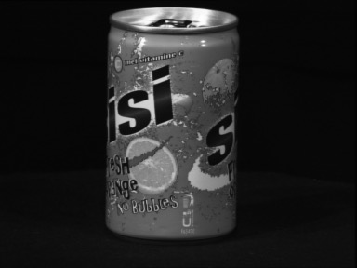
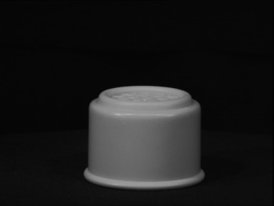


Introduction
High-dimensional data can often be clustered meaningful in multiple ways, each way can create a low-dimensional subspace.
Subspace 1-shape
Subspace 2-color

Slide 6
Introduction
NR-Kmeans
Find multiple non-redundant clusterings
Orthogonal, arbitrarily oriented subspaces
Perform K-means clustering algorithm in each subspaces
Parameters: number of subspace and k for each subspace
Simultaneous optimization of all clusterings

Slide 7
Part two
Non-Redundant K-means of 2 subspaces
Presented by Wang Dezhao

Slide 8

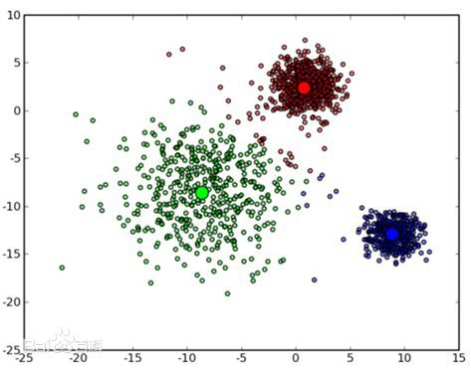
Cost Function
μ(j , i): Original space mean of cluster i in subspace j
V: orthogonal matrix of a rigid transformation
Pj: Projection onto the j’th subspace

Slide 9
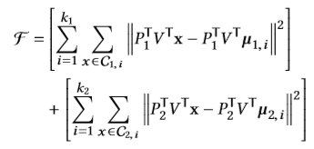



Optimization Algorithm
In the case of 2 subspaces (m_{j} is the dimensionality of the j’th subspace)
ss
(1)The trace function yields the sum of the eigenvalues
${(2)P}_{1}P_{1}^{T}$--diagonal matrix, it leaves the upper left m₁*m₁ entries of $V^{T}\left[Σ_{1}−Σ_{2}\right]V$
Thus, it is possible to minimize the cost function by projecting the m₁-smallest eigenvalues onto the first subspace
V is defined as an orthogonal matrix

Slide 10
Part 3
Optimization of V in the general case: S>2
Presented by Zhao Peiyao

Slide 11
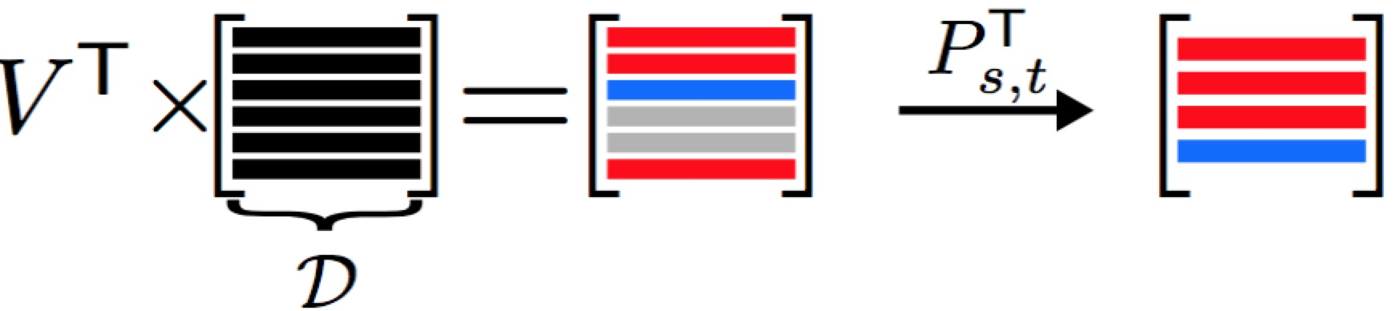
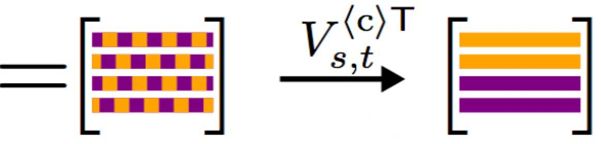
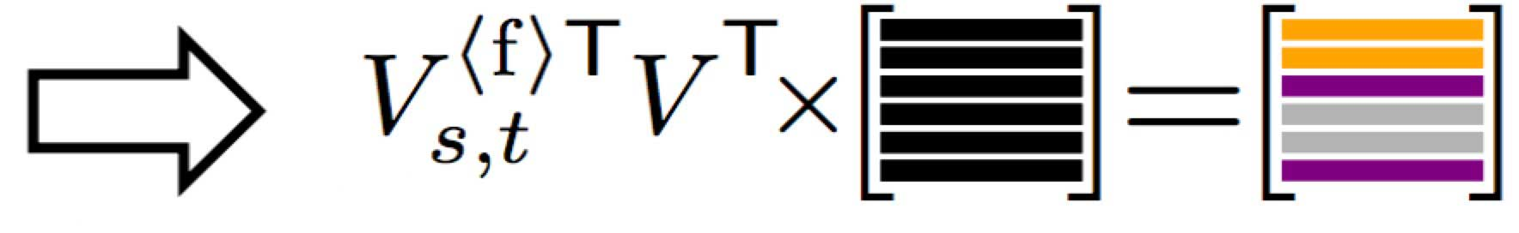
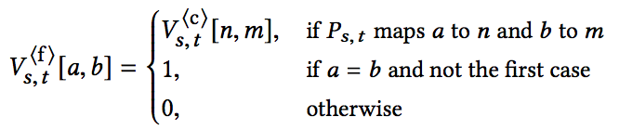
General Case
Optimization of V in the general case S>2
Trick: We consider the clusterings pair-wise as the S=2 special case
Rotation matrix within the combined space
mapping
Rotation matrix in the original space

Slide 12
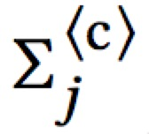
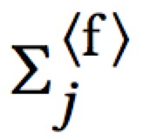
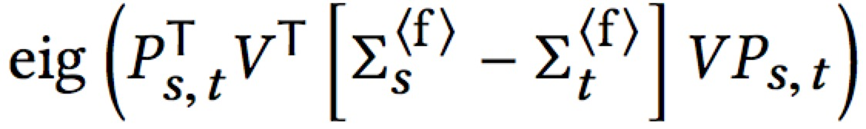
Accelerating
Further: Combined space
can be calculated from full space
# Pre-compute
# Perform
Update V

Slide 13
Part four
Pseudocode
Presented by Yao Xiaoying

Slide 14
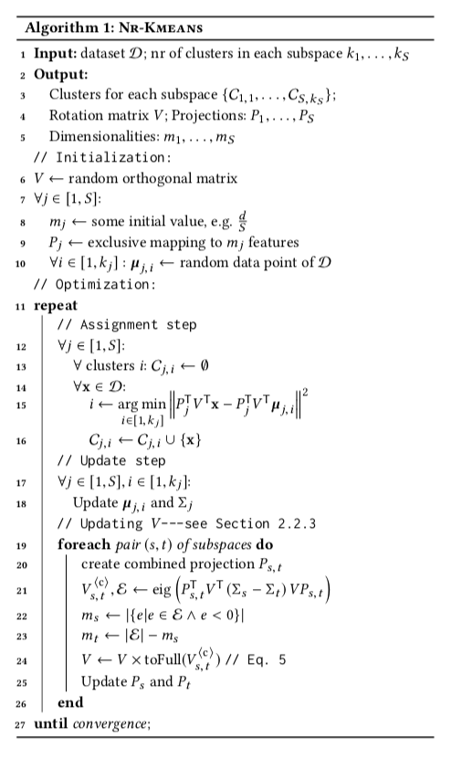
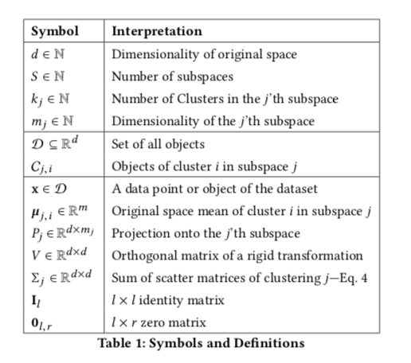
Pseudocode

Slide 15
Complexity
Lloyd’s Algorithm
$$O(Idk|D|)$$
Scatter Matrices
$$O(Sd^{2}\left|D\right|)$$
Eigen- Decomposition
$$O(S^{2}d^{3})$$
Total Complexity
$O(I\left(dk_{total}\left|D\right|+d^{2}S\left|D\right|+S^{2}d^{3}\right))$

Slide 16
Part 5
EXPERIMENTS
Presented by Zhang Zixuan

Slide 17
Dataset
Dancing Stickfigures Dataset
+ Clutter

Slide 18
Dataset
+ Clutter
Upper Body

Slide 19
Dataset
+ Clutter
Lower Body

Slide 20
Expected results
+ Clutter

Slide 21
Researcher’s results

Slide 22
Our Experiments
1
2
3
(2)
660826085
(2, 2)
(3)
428509292
436053144
(2, 3)
(2, 2, 2)
203736367
216844003

Slide 23
Our Experiments
1
2
3
4
(2)
660826085
(2, 2)
(3)
428509292
436053144
(2, 3)
(2, 2, 2)
203736367
216844003
(3, 3)
(2, 4)
(2, 3, 2)
17618422
171330200
30725095

Slide 24
Our Experiments
1
2
3
4
5
(2)
660826085
(2, 2)
(3)
428509292
436053144
(2, 3)
(2, 2, 2)
203736367
216844003
(3, 3)
(2, 4)
(2, 3, 2)
17618422
171330200
30725095
(3, 3, 2)
(3, 4)
5294973
13484040

Slide 25
Our Experiments
1
2
3
4
5
6
(2)
660826085
(2, 2)
(3)
428509292
436053144
(2, 3)
(2, 2, 2)
203736367
216844003
(3, 3)
(2, 4)
(2, 3, 2)
17618422
171330200
30725095
(3, 3, 2)
(3, 4)
5294973
13484040
(3, 3, 3)
(4, 3, 2)
(3, 3, 2,2)
4078077
5239988
5261319

Slide 26
Questions
3,3
3,3,3

Slide 27
Thank You for Listening

